Slide 1







DIGITAL
MARKETING
BY SAKIRA & PRASHANT

Slide 2



Contents
1
5
ABSTRACT
RESEARCH AND FINDINGS
2
6
INTRODUCTION
OPPORTUNITIES
3
7
PROBLEM STSTEMENT
CHALLENGES
4
8
OBJECTIVE OF THE STUDY
CONCLUSION

Slide 3



Abstract
Digital marketing has revolutionized business strategies, enabling brands to reach global audiences more efficiently.Despite its benefits, businesses face challenges in leveraging digital marketing effectively. This study explores key strategies and their effectiveness of digital marketing.

Slide 4


Introduction
Digital marketing is the use of online platforms and digital technologies to promote products and services.
Use of social media, email marketing, influencer collaborations to connect with their ideal audience.
Transforms traditional marketing strategies.
Enhances customer reach and engagement.
Increases brand visibility and sales.

Slide 5
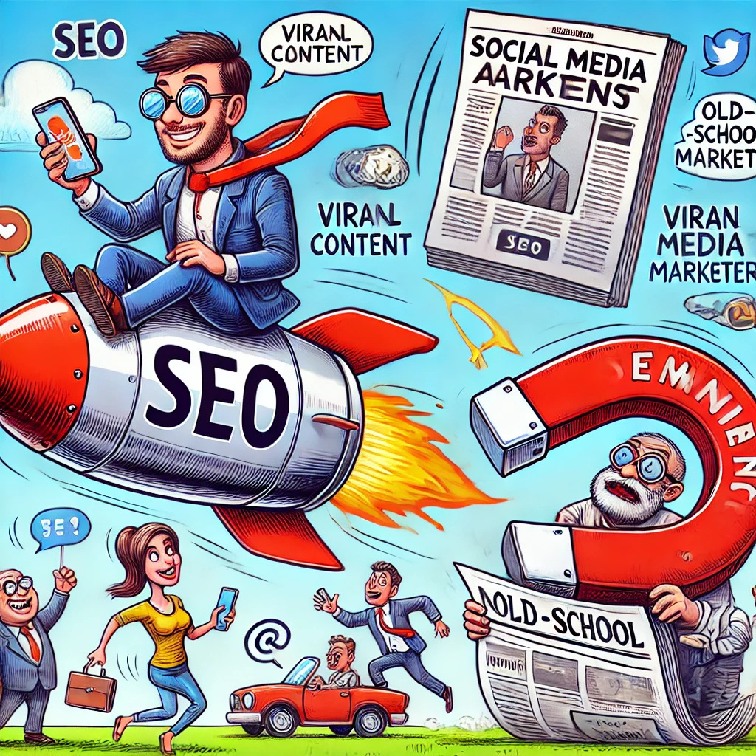
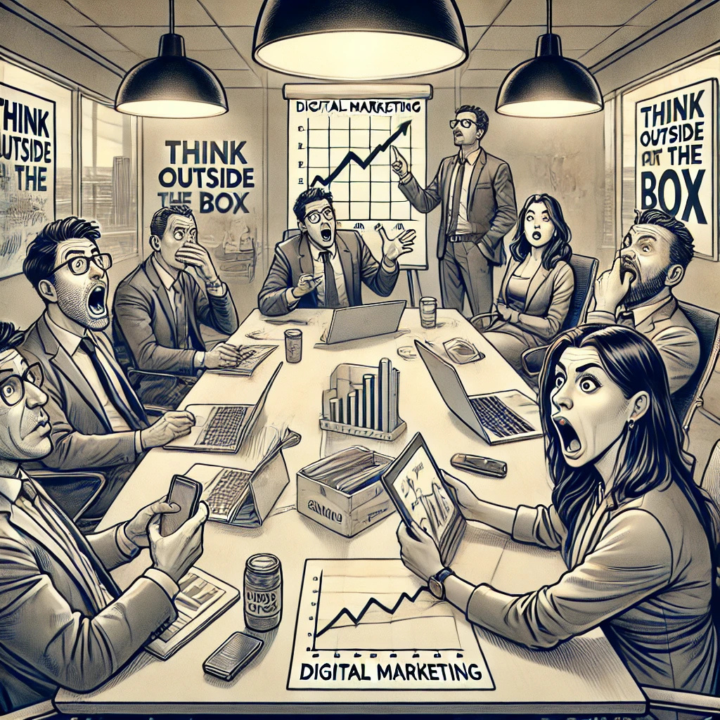
"Digital marketing: where you pay a lot of money to make people ignore your ads.”
“Digital marketing is the art of convincing people to buy things they didn’t know they needed.”

Slide 6





Problem Statement
Many businesses struggle to implement effective digital marketing due to a lack of expertise, resources, or understanding of digital trends. Measuring success and maintaining a competitive edge are ongoing challenges. This study seeks to answer:
How can businesses effectively integrate digital marketing to maximize growth ?
What are the key challenges businesses face in implementing digital marketing strategies?

Slide 7


Objectives
To understand the core principles of digital marketing.
To analyze the effectiveness of digital marketing strategies.
To identify opportunities in the digital marketing landscape.
To explore challenges businesses, face in digital marketing.

Slide 8



Research and Findings
Research Methodology
Findings
This study employs a mixed-methods design to investigate the effectiveness, challenges, and opportunities of digital marketing. Through qualitative research, content analysis and case study this study studies the gist matter on digital marketing.
Core Strategies: SEO, content marketing, social media, email marketing, PPC etc.
Challenges: Lack of skills, evolving algorithms, budget constraints, ROI measurement, and competition.
Opportunities: Global Reach & Market Expansion, Cost Efficiency, Engagement with customers etc.

Slide 9




Global Reach
Targeted Advertising
Businesses can connect with a vast audience beyond geographical limits at a lower cost.
Advanced data analytics allow precise targeting based on demographics, interests, and behaviors.
Cost-Effectiveness
Opportunities
Brand Awareness
Online marketing strategies, like social media and email campaigns, offer high ROI at lower costs.
SEO, content marketing, and influencer collaborations boost online visibility and credibility.
Customer Engagement
Competitive Advantage
Interactive content, social media, and personalized marketing enhance customer relationships.
A strong digital presence helps businesses stand out in a highly competitive market.

Slide 10

High Competition
Budget Constraints
The digital space is crowded, making it difficult to stand out.
Small businesses struggle to compete with larger brands that have bigger budgets.
Maintaining Customer Engagement
Ad Fatigue
Challenges
Retaining audience attention amidst distractions is increasingly difficult.
Overexposure to ads reduces effectiveness and customer interest.
Constant Algorithm Changes
Multigenerational Audiences
Tailoring strategies for diverse age groups and preferences can be challenging.
Frequent updates on platforms like Google, Facebook, and Instagram affect visibility.

Slide 11


Conclusion
Digital marketing is crucial for business growth, offering targeted, cost-effective strategies. While challenges like competition and data privacy exist, businesses can thrive by embracing innovation and staying agile. A dynamic digital strategy ensures long-term success and competitiveness.

Slide 12




Presented by;
Sakira Tandukar (22)
Prashant Thapa (19)

